Slide 1
Department of Software Engineering Faculty of Electrical Engineering University of Belgrade Homework Assassin's Creed
Student: Pera Perić 2018/0018
Supervisor: Dr Miloš Đurić

Slide 2
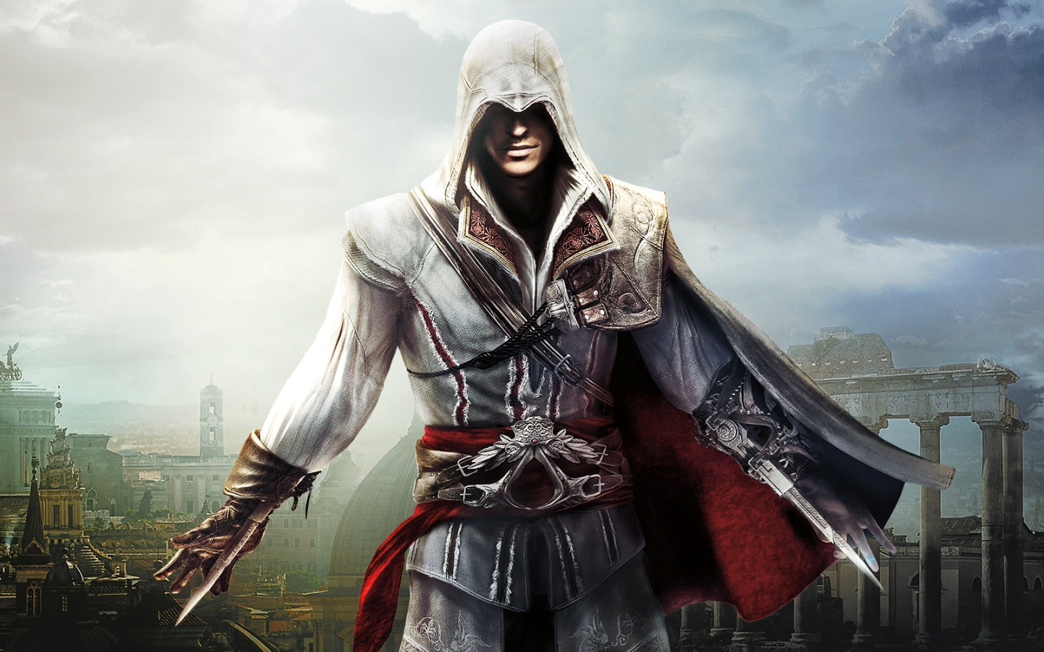

Slide 3
Brief intro
Assassin's Creed is a franchise centered on an action-adventure video game series developed by Ubisoft. It depicts a centuries-old struggle pitting the Assassins, who fight for peace and free will, against the Templars, who believe peace comes through control of humanity.

Slide 4
Historical fiction
The series features historical fiction mixed with real-world historical events and figures. The series took inspiration from the novel Alamut by the Slovenian writer Vladimir Bartol, while building upon concepts from the Prince of Persia series.

Slide 5
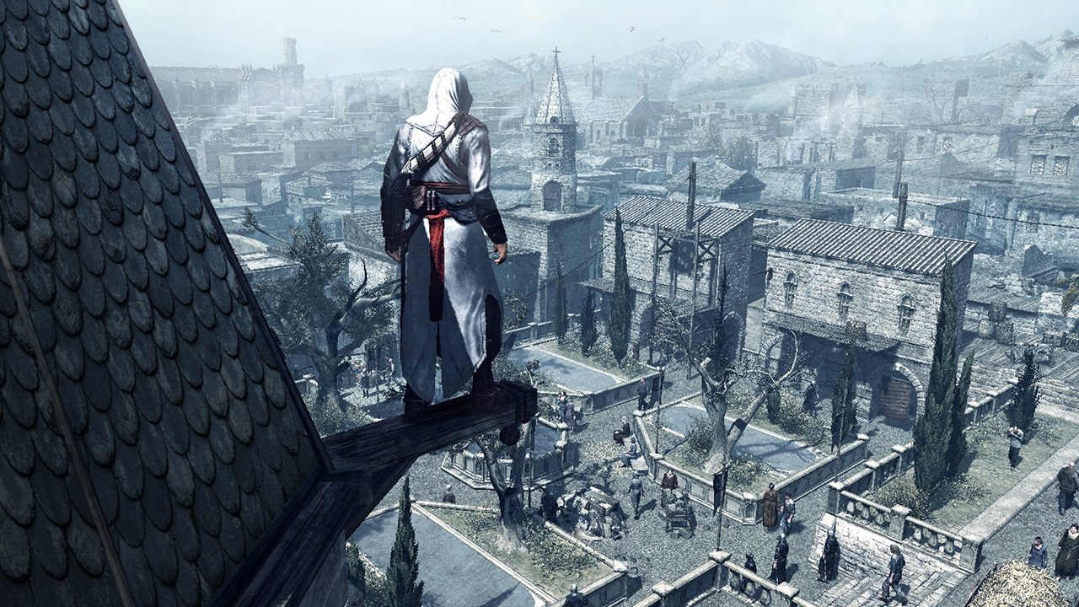

Slide 6
Protagonists
Desmond Miles, a bartender who is a descendant of several lines of prominent Assassins; though raised as an Assassin, he left his nomadic family to seek out a more common lifestyle.

Slide 7
Details
He is initially kidnapped by Abstergo, who is aware of his ancestral lineage. Desmond is forced into the Animus and is revealed to be subject 17; many of the sixteen previous subjects died as a result of animus over-exposure.

Slide 9
Thank you for your attention

